Slide 1

PYTHON
CLASSES

Slide 2
CLASS
A class is a template for an object.
Classes are created by keyword class.
Attributes are variable that belong to that class.
Attributes are always public and can be accessed by dot operator.

Slide 3
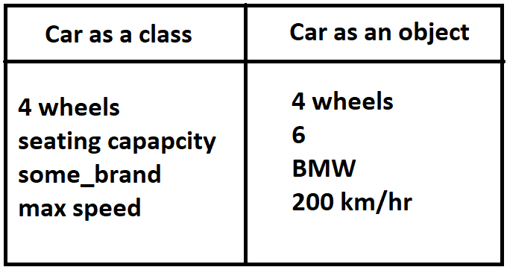
Color
Black

Slide 4
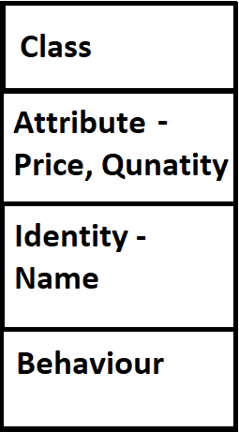

Slide 5
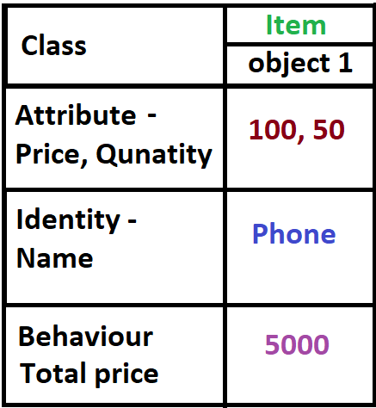

Slide 6
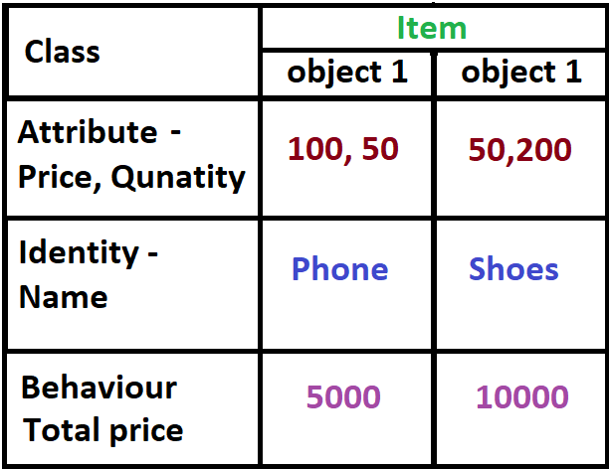

Slide 7
initializer function
__init__ functions represents the initializer function in python
All initializer function have the basic arguments that will be automatically initialized just after defining the object.

Slide 8

OBJECTIVES
About Class
Creation of Class
The __init__ function

